Slide 1


Edgar Tijerina Tamez
07/Oct/2025

Slide 2

Outline
Executive Summary
Introduction
Methodology
Results
Conclusion
Appendix

Slide 3
Executive Summary
Exploratory data analysis was conducted using a predictive approach to find patterns, distributions, correlations and anomalies, using the SpaceX REST API as the main data source. Complementary data was sourced from Wikipedia using web scrapping techniques. Data was cleaned and prepared for machine learning using One Hot Encoding. Interactive visual analytics were developed with Folium as well interactive dashboards using Plotly Dash. Machine learning pipelines were set up to test multiple classifiers, including Logistic Regression, Support Vector Machine (SVM), Decision Tree Classifier and K-Nearest Neighbors (KNN). Model hyperparameters where optimized and the results visualized on Confusion matrices.
From the exploratory data analysis we can observe that landing success rate has been increasing since 2010 reaching 80% success rate as of 2020. We can also observe that Geostationary Orbits (GTO) had the lowest success rate with 50%. All machine learning prediction models reached an 83% accuracy. The confusion matrices demonstrated the ability of the model to predict with perfect accuracy True Positives (Successful landings) but struggled with predict True Negatives (Failed landing).

Slide 4
Introduction
Launching rockets is a multi million-dollar endeavor. Right now, the space launch market is entirely dominated by SpaceX, composing over 75% of all commercial launches as of 2023. Their main advantage is their ability to reuse their rockets, cutting their costs per launch from $150 million to $97 million.
Being able to predict whether the first stage will land would give an advantage to competitors by estimating launch costs.

Slide 5

Section 1

Slide 6
Methodology
Executive Summary
Data was collected from two main sources: SpaceX API using Python’s Requests module and Wikipedia Falcon 9 launch records using BeautifulSoup.
Data was cleaned and transformed using Pandas and Numpy. One hot encoding was used to transform the data in preparation for machine learning.
EDA was performed using matplotlib and seaborn for plotting and key data points were extracted using SQL.
Interactive visual analytics were developed with Folium as well interactive dashboards using Plotly Dash.
Machine learning pipelines were set up to test multiple classification models, including Logistic Regression, Support Vector Machine (SVM), Decision Tree Classifier and K-Nearest Neighbors (KNN). Model hyperparameters where optimized and the results visualized on Confusion matrices.
Notes:
Executive Summary
Data collection methodology:
Data was collected from two main sources: SpaceX API using Python’s Requests module and Wikipedia Falcon 9 launch records using BeautifulSoup.
Data wrangling:
Data was cleaned and transformed using Pandas and Numpy. One hot encoding was used to transform the data in preparation for machine learning.
Exploratory data analysis (EDA) using visualization and SQL:
EDA was performed using matplotlib and seaborn for plotting and key data points where extracted using SQL
Perform interactive visual analytics using Folium and Plotly Dash
Perform predictive analysis using classification models
How to build, tune, evaluate classification models

Slide 7
Data Collection
Start
Data was collected from two main sources: SpaceX API using Python’s Requests module and Wikipedia Falcon 9 launch records using BeautifulSoup.
Data Sources
SpaceX API
Wikipedia Falcon 9 Launch Records
Requests
BeautifulSoup
Dataset_part_1.csv
Spacex_web_scraped.csv
Notes:
Describe how data sets were collected.
You need to present your data collection process use key phrases and flowcharts

Slide 8
Data Collection – SpaceX API
The primary source of data is the SpaceX REST API -> api.spacexdata.com/v4/
Its key endpoints are:
/launches/past -> past launch data (main dataset).
/capsules, /cores, /payloads, /launchpads -> detailed info by ID.
Using Python requests we obtained JSON objects
By using json_normalise from Pandas DataFrame we transform the data into a tabular structure
Notebook link:
https://github.com/EdgarHTT/Applied_Data_Science_Capstone/blob/main/jupyter-labs-spacex-data-collection-api.ipynb
Notes:
Present your data collection with SpaceX REST calls using key phrases and flowcharts
Add the GitHub URL of the completed SpaceX API calls notebook (must include completed code cell and outcome cell), as an external reference and peer-review purpose

Slide 9
Data Collection – SpaceX API
Requests
GET
Endpoint | https://api.spacexdata.com/v4/launches/past
Response | JSON response
Endpoint | https://api.spacexdata.com/v4/cores/{core}
Response | block reuse_count serial landing_success, landing_type flight gridfins reused legs landpad
Endpoint | https://api.spacexdata.com/v4/payloads/{payload}
Response | mass_kg orbit
response.json()
response
Endpoint | https://api.spacexdata.com/v4/launchpads/{launchpad}
Response | Longitude Latitude Name
GET
data
Endpoint | https://api.spacexdata.com/v4/rockets/{rocket}
Response | name
pd.json_normalize(data)
dataframe
Filter for only Falcon 9
Replace Null values in Payload mass with mean
launch_dict
Notebook link:
https://github.com/EdgarHTT/Applied_Data_Science_Capstone/blob/main/jupyter-labs-spacex-data-collection-api.ipynb
Dataset_part_1.csv
Notes:
Present your data collection with SpaceX REST calls using key phrases and flowcharts
Add the GitHub URL of the completed SpaceX API calls notebook (must include completed code cell and outcome cell), as an external reference and peer-review purpose

Slide 10
Data Collection - Scraping
Endpoint | https://en.wikipedia.org/wiki/List_of_Falcon_9_and_Falcon_Heavy_launches
Response | HTTP
Requests was used in tandem with BeautifulSoup to parse and scrape the List of Falcon 9 and Falcon Heavy launches from Wikipedia. The parsed data was converted into a Pandas Dataframe and stored for further use.
Requests
GET
soup obj
BeautifulSoup()
response
soup.find_all(‘table’)[2]
first_launch_table
column_names
Extraction functions
Spacex_web_scraped.csv
Pd.DataFrame()
launch_dict
Notebook link:
https://github.com/EdgarHTT/Applied_Data_Science_Capstone/blob/main/jupyter-labs-webscraping.ipynb
Notes:
Present your web scraping process using key phrases and flowcharts
Add the GitHub URL of the completed web scraping notebook, as an external reference and peer-review purpose

Slide 11
Data Wrangling
Data wrangling conforms exploratory data analysis and the determination of training labels. By analyzing the dataset, we classified the outcome of each landing in a binary format and incorporated it into the dataset for future feature engineering.
Data Analysis
pd.read_csv
Dataset_part_1.csv
start
% missing values
Data types
dataFrame
dataset_part_2.csv
end
# of launches on each launch site
Success:
1
join
# of each orbit
# of each landing outcome
outcome
Landing class
Landing success rate
Failure:
0
class mean
Notebook:
https://github.com/EdgarHTT/Applied_Data_Science_Capstone/blob/main/labs-jupyter-spacex-Data%20wrangling.ipynb
Notes:
Describe how data were processed
You need to present your data wrangling process using key phrases and flowcharts
Add the GitHub URL of your completed data wrangling related notebooks, as an external reference and peer-review purpose

Slide 12
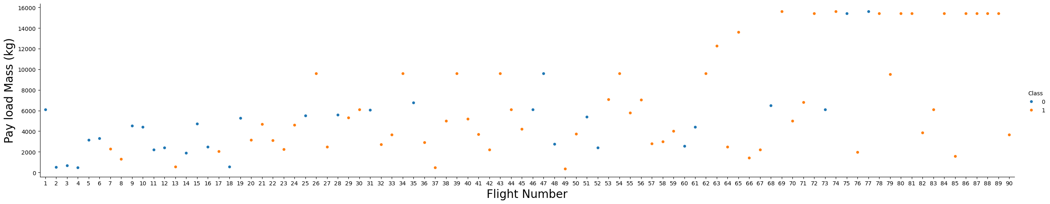
EDA with Data Visualization
As part of the exploratory data analysis, visualizations are developed to obtain a deeper understanding and find insights.
By plotting Flight number against Payload mass, we can observe that the success rate of each launch increases. Payload mass and landing success doesn’t seem to be correlated
Notes:
Summarize what charts were plotted and why you used those charts
Add the GitHub URL of your completed EDA with data visualization notebook, as an external reference and peer-review purpose

Slide 13
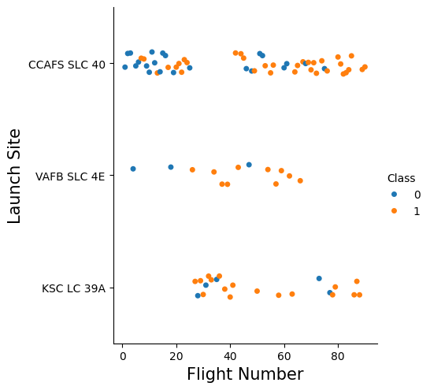
EDA with Data Visualization
By visualizing the relationship between flight number and launch site, we can observe that the first launches done by SpaceX was on Cape Canaveral and that most of their failures were done there.
Notes:
Summarize what charts were plotted and why you used those charts
Add the GitHub URL of your completed EDA with data visualization notebook, as an external reference and peer-review purpose

Slide 14
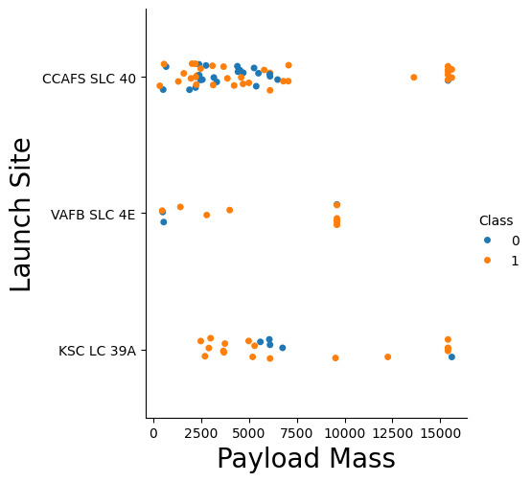
EDA with Data Visualization
And by plotting against payload mass, we can see that for the VAFB-SLC launch site no heavy payload rockets were launched.
Notes:
Summarize what charts were plotted and why you used those charts
Add the GitHub URL of your completed EDA with data visualization notebook, as an external reference and peer-review purpose

Slide 15
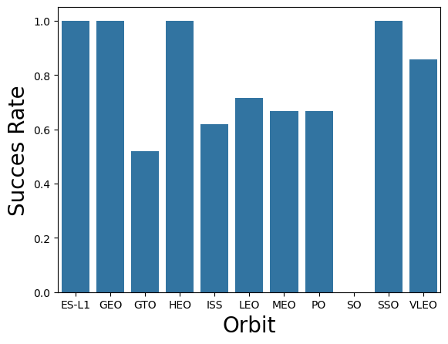
EDA with Data Visualization
By plotting the success rate of each orbit, we can see that Geo Stationary Orbits (GTO) are the most difficult launches to land.
Notes:
Summarize what charts were plotted and why you used those charts
Add the GitHub URL of your completed EDA with data visualization notebook, as an external reference and peer-review purpose

Slide 16
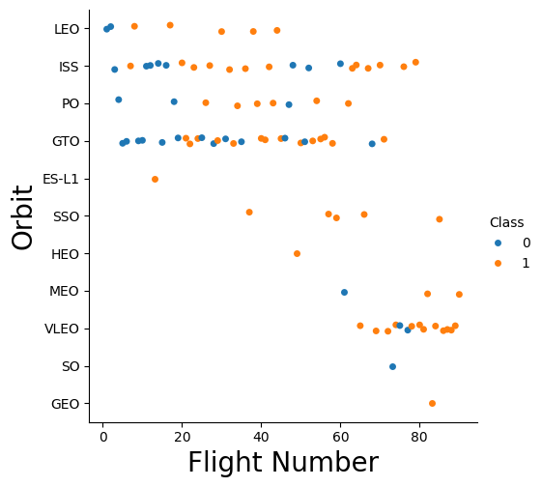
EDA with Data Visualization
As of now the most common mission by SpaceX is Very Low Earth Orbit (VLEO). This orbit is most common for satellite missions like their Starlink service
Notes:
Summarize what charts were plotted and why you used those charts
Add the GitHub URL of your completed EDA with data visualization notebook, as an external reference and peer-review purpose

Slide 17
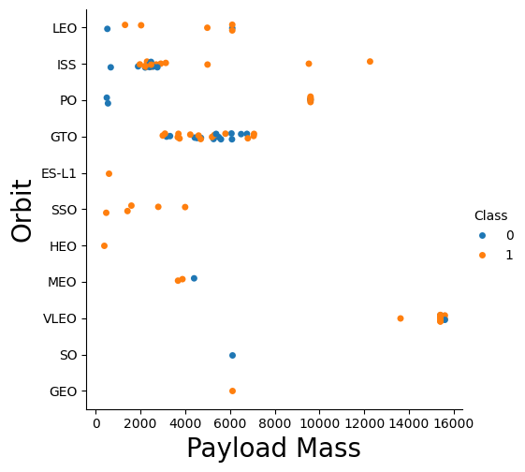
EDA with Data Visualization
With heavy payloads the successful landing rate is increased for Polar, LEO and ISS.
However, for GTO, it’s difficult to distinguish between successful and unsuccessful landings
Notes:
Summarize what charts were plotted and why you used those charts
Add the GitHub URL of your completed EDA with data visualization notebook, as an external reference and peer-review purpose

Slide 18
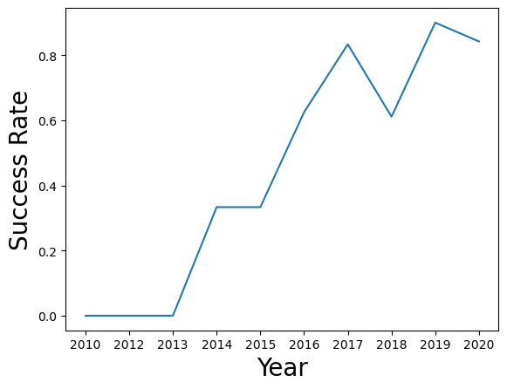
EDA with Data Visualization
Finally, we can observe that the success rate kept increasing from 2013 till 2020
Notes:
Summarize what charts were plotted and why you used those charts
Add the GitHub URL of your completed EDA with data visualization notebook, as an external reference and peer-review purpose

Slide 19
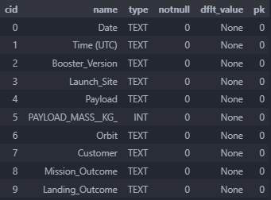
EDA with SQL
SQL was also used to perform exploratory data analysis. Here are the queries used:
%sql PRAGMA table_info([SPACEXTABLE])
This query gives us details about the table’s columns.
Notebook:
https://github.com/EdgarHTT/Applied_Data_Science_Capstone/blob/main/jupyter-labs-eda-sql-coursera_sqllite.ipynb
Notes:
Using bullet point format, summarize the SQL queries you performed
Add the GitHub URL of your completed EDA with SQL notebook, as an external reference and peer-review purpose

Slide 20
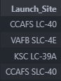
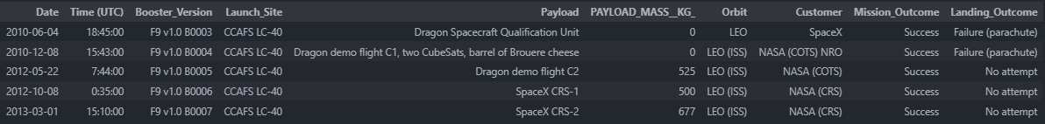
EDA with SQL
%sql SELECT DISTINCT("Launch_Site") FROM SPACEXTABLE
Displays the name of the unique launch sites
%%sql
SELECT * FROM SPACEXTABLE
WHERE "Launch_Site" LIKE 'CCA%'
LIMIT 5
Displays 5 records where launch sites begin with “CCA”
Notes:
Using bullet point format, summarize the SQL queries you performed
Add the GitHub URL of your completed EDA with SQL notebook, as an external reference and peer-review purpose

Slide 21
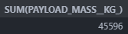

EDA with SQL
%%sql
SELECT SUM(PAYLOAD_MASS__KG_) FROM SPACEXTABLE
WHERE Customer = 'NASA (CRS)’
Displays the total payload mass carried by boosters launched by NASA (CRS)
%%sql
SELECT AVG(PAYLOAD_MASS__KG_) FROM SPACEXTABLE
WHERE "Booster_Version" LIKE "F9 v1.1%“
Displays average payload mass carried by booster version F9 v1.1
Notes:
Using bullet point format, summarize the SQL queries you performed
Add the GitHub URL of your completed EDA with SQL notebook, as an external reference and peer-review purpose

Slide 22

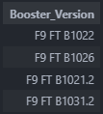
EDA with SQL
%%sql
SELECT MIN(DATE) FROM SPACEXTABLE
WHERE Landing_Outcome = "Success (ground pad)"
Date of the first successful landing outcome in ground pad
%%sql
SELECT Booster_Version FROM SPACEXTABLE
WHERE Landing_Outcome = "Success (drone ship)" AND PAYLOAD_MASS__KG_ BETWEEN 4000 AND 6000
Lists the names of the boosters which have successfully landed on a drone ship and had a mass between 4000 and 6000 kgA
Notes:
Using bullet point format, summarize the SQL queries you performed
Add the GitHub URL of your completed EDA with SQL notebook, as an external reference and peer-review purpose

Slide 23
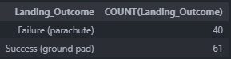
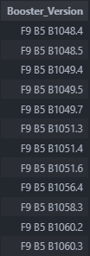
EDA with SQL
%%sql
SELECT Landing_Outcome, COUNT(Landing_Outcome) FROM SPACEXTABLE
GROUP BY Landing_Outcome LIKE "Success%" OR "Failure%“
List the total number of successful and failure mission outcomes (note that the names between parenthesis do not indicate the class of outcome)
%%sql
SELECT Booster_Version FROM SPACEXTABLE
WHERE PAYLOAD_MASS__kg_ =
(SELECT MAX(PAYLOAD_MASS__KG_) FROM SPACEXTABLE)
GROUP BY Booster_Version
Lists all the booster versions that have carried the maximum payload
Notes:
Using bullet point format, summarize the SQL queries you performed
Add the GitHub URL of your completed EDA with SQL notebook, as an external reference and peer-review purpose

Slide 24
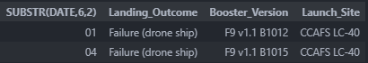
EDA with SQL
%%sql
SELECT SUBSTR(DATE,6,2), Landing_Outcome, Booster_Version, Launch_Site FROM SPACEXTABLE
WHERE SUBSTR(DATE,0,5) = '2015' AND Landing_Outcome = 'Failure (drone ship)’
List and displays month number, landing outcome, booster version and launch site of rockets launched on the year 2015 which ended on a failure to land on a drone ship
Notes:
Using bullet point format, summarize the SQL queries you performed
Add the GitHub URL of your completed EDA with SQL notebook, as an external reference and peer-review purpose

Slide 25
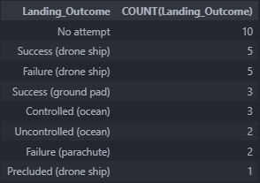
EDA with SQL
%%sql
SELECT Landing_Outcome, COUNT(Landing_Outcome) FROM SPACEXTABLE
WHERE DATE BETWEEN "2010-06-04" AND "2017-03-20"
GROUP BY Landing_Outcome
ORDER BY COUNT(Landing_Outcome) DESC
Ranks by count of landing outcomes between the date of 2010-06-04 and 2017-03-20 , in descending order.
Notes:
Using bullet point format, summarize the SQL queries you performed
Add the GitHub URL of your completed EDA with SQL notebook, as an external reference and peer-review purpose

Slide 26
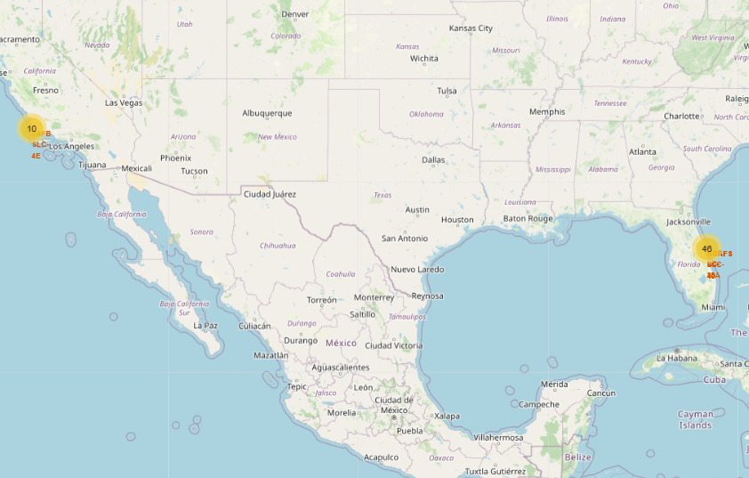
Build an Interactive Map with Folium
To explore how locations and its proximities affect the landing success rate an interactive map was constructed. Details were marked, these included calculated proximities to railways, cities, coastlines and highways. Successful and failed landings were clustered into their respective launch site.
Notebook:
https://github.com/EdgarHTT/Applied_Data_Science_Capstone/blob/main/jupyter-labs-eda-sql-coursera_sqllite.ipynb
Notes:
Summarize what map objects such as markers, circles, lines, etc. you created and added to a folium map
Explain why you added those objects
Add the GitHub URL of your completed interactive map with Folium map, as an external reference and peer-review purpose

Slide 27
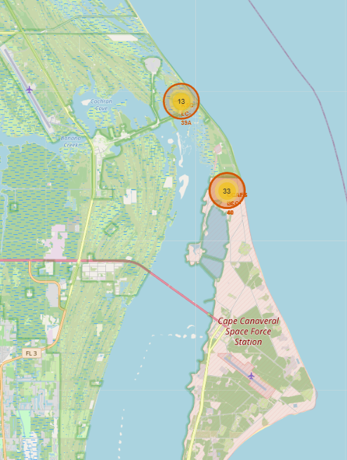
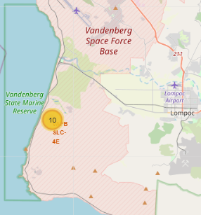
Build an Interactive Map with Folium
Clustering let us visualize the number of launches per launch site.
Notes:
Summarize what map objects such as markers, circles, lines, etc. you created and added to a folium map
Explain why you added those objects
Add the GitHub URL of your completed interactive map with Folium map, as an external reference and peer-review purpose

Slide 28
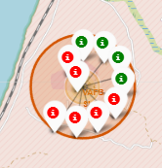
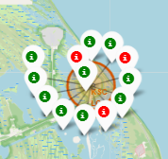
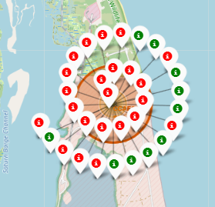
Build an Interactive Map with Folium
Clustering also let us see failed and successful launches easily
CCAFS LC-40
&
CCAFS SLC-40
VAFB SLC-4E
KSC LC-39A
Notes:
Summarize what map objects such as markers, circles, lines, etc. you created and added to a folium map
Explain why you added those objects
Add the GitHub URL of your completed interactive map with Folium map, as an external reference and peer-review purpose

Slide 29
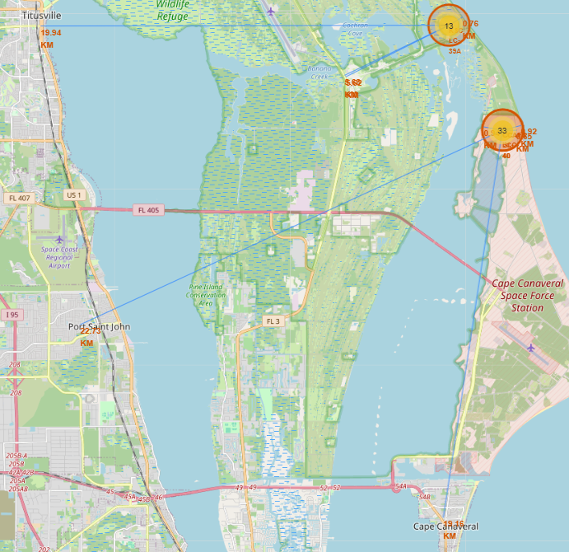
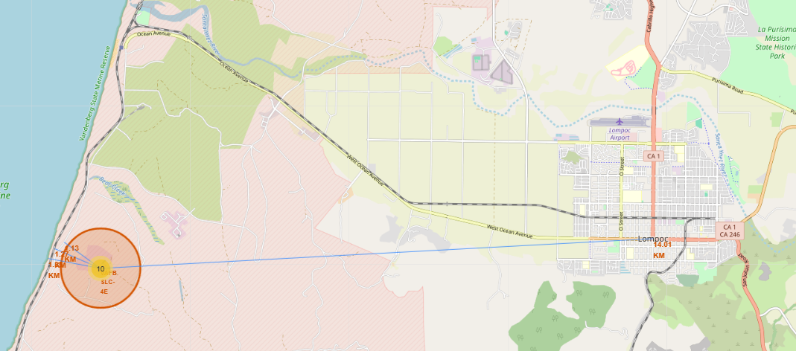
Build an Interactive Map with Folium
The closest city was Lompoc with 14 km. Launch sites are usually close to a coastline and some public infrastructure, like highways and railways. But their location is instead the determining factor of which type of mission can the site launch.
Notes:
Summarize what map objects such as markers, circles, lines, etc. you created and added to a folium map
Explain why you added those objects
Add the GitHub URL of your completed interactive map with Folium map, as an external reference and peer-review purpose

Slide 30
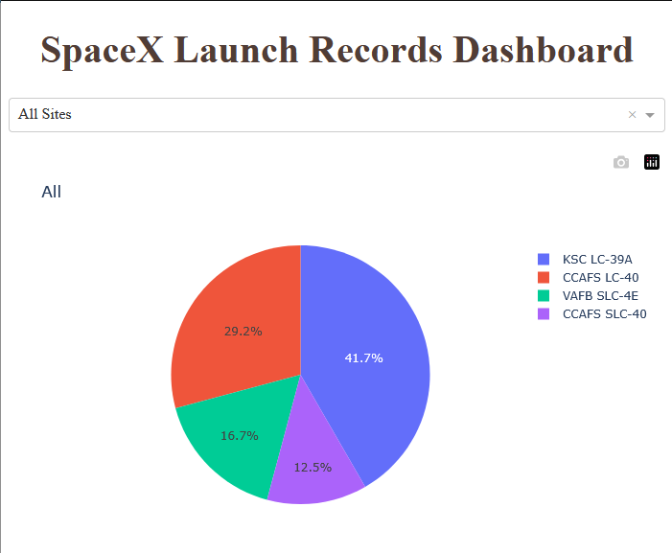
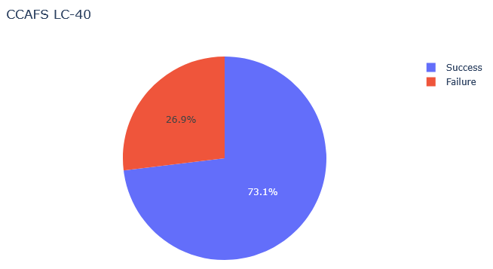
Build a Dashboard with Plotly Dash
A dashboard using Plotly Dash with some plots and interactions were developed to better explore the data extracted
A pie plot showcases the share of launches per site. You can select the site on a dropdown list which then shows the share of successful and failed launches
Notebook:
https://github.com/EdgarHTT/Applied_Data_Science_Capstone/blob/main/spacex-dash-app.py
Notes:
Summarize what plots/graphs and interactions you have added to a dashboard
Explain why you added those plots and interactions
Add the GitHub URL of your completed Plotly Dash lab, as an external reference and peer-review purpose

Slide 31
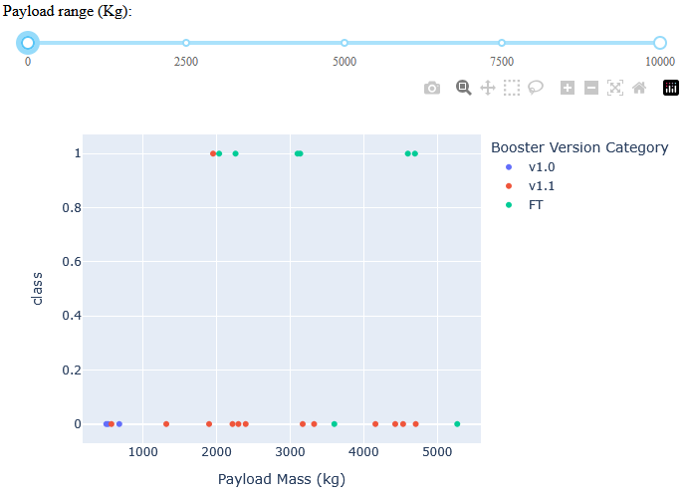
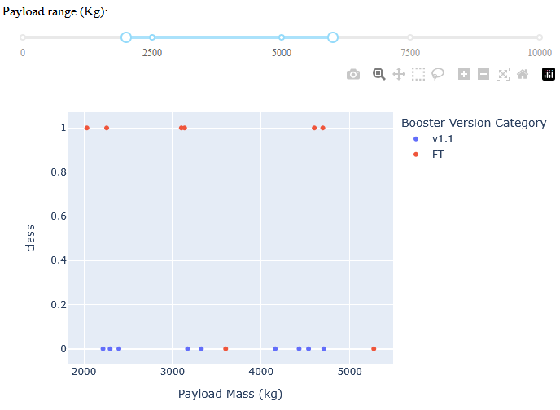
Build a Dashboard with Plotly Dash
A scatter plot is used to represent the different outcomes of each launch, separated by booster version.
A slider can be used to filter by payload range
Notes:
Summarize what plots/graphs and interactions you have added to a dashboard
Explain why you added those plots and interactions
Add the GitHub URL of your completed Plotly Dash lab, as an external reference and peer-review purpose

Slide 32
Predictive Analysis (Classification)
To build and train the classification model, feature engineering was performed on the dataset. Categorical data was transformed into numerical values by using One-hot encoding techniques. Once the dataset was ready, we proceeded to fit, transform and split into training and testing data. To determine the optimal hyper parameters, grid search was performed on each model. Score was calculated and a confusion matrix plotted to find the best model.
Dataset_part_2.csv
One-hot encoding
Dataset_part_3.csv
Train test split
X
Fit and transform
Testing data
Training data
Confusion Matrix
Fit
Models
Scoring
Notebook:
https://github.com/EdgarHTT/Applied_Data_Science_Capstone/blob/main/SpaceX_Machine%20Learning%20Prediction_Part_5.ipynb
GridSearchCV:
-Model
-Parameters
-Cross validation of 10
Models:
Logistic Regression
Support Vector Machine
Decision Tree
K Nearest Neighbors
Notes:
Summarize how you built, evaluated, improved, and found the best performing classification model
You need present your model development process using key phrases and flowchart
Add the GitHub URL of your completed predictive analysis lab, as an external reference and peer-review purpose

Slide 33
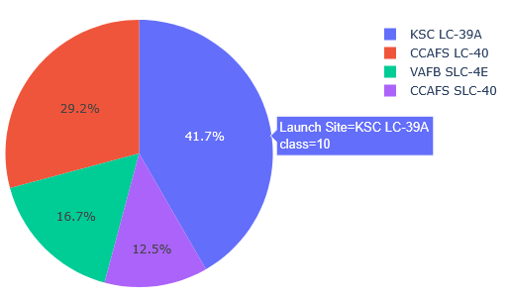
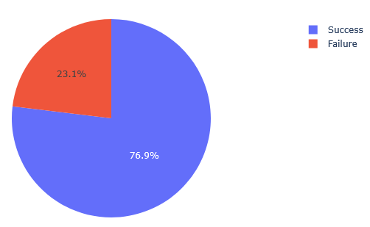
Results
These are some of the most important results obtained of each section:
Exploratory data analysis:
The success rate of each launch has been increasing since 2013
Interactive analytics demo:
Kennedy space center LC-39A is the most used launch pad. With a 78% success rate
Notes:
Exploratory data analysis results
Interactive analytics demo in screenshots
Predictive analysis results

Slide 34

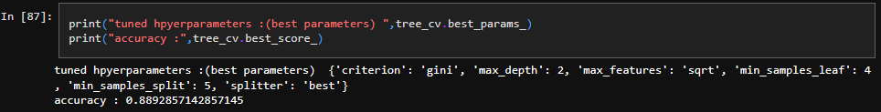
Results
These are some of the most important results obtained of each section:
Predictive analysis results:
Of the 4 models tested, decision tree classifier obtained the best results with a score of 0.89 and a good distribution of Truth table predictions on test data.
Notes:
Exploratory data analysis results
Interactive analytics demo in screenshots
Predictive analysis results

Slide 35

Section 2

Slide 36
Flight Number vs. Launch Site
By visualizing the relationship between flight number and launch site, we can observe that the first launches done by SpaceX was on Cape Canaveral and that most of their failures were done there.

Slide 37
Payload vs. Launch Site
And by plotting against payload mass, we can see that for the VAFB-SLC launch site no heavy payload rockets were launched.

Slide 38
Success Rate vs. Orbit Type
By plotting the success rate of each orbit, we can see that Geo Stationary Orbits (GTO) are the most difficult launches to land.

Slide 39
Flight Number vs. Orbit Type
As of now the most common mission by SpaceX is Very Low Earth Orbit (VLEO). This orbit is most common for satellite missions like their Starlink service

Slide 40
Payload vs. Orbit Type
With heavy payloads the successful landing rate is increased for Polar, LEO and ISS.
However, for GTO, it’s difficult to distinguish between successful and unsuccessful landings

Slide 41
Launch Success Yearly Trend
Finally, we can observe that the success rate kept increasing from 2013 till 2020

Slide 42
All Launch Site Names
%sql SELECT DISTINCT("Launch_Site") FROM SPACEXTABLE
Displays the name of the unique launch sites

Slide 43
Launch Site Names Begin with 'CCA'
%%sql
SELECT * FROM SPACEXTABLE
WHERE "Launch_Site" LIKE 'CCA%'
LIMIT 5
Displays 5 records where launch sites begin with “CCA”

Slide 44
Total Payload Mass
%%sql
SELECT SUM(PAYLOAD_MASS__KG_) FROM SPACEXTABLE
WHERE Customer = 'NASA (CRS)’
Displays the total payload mass carried by boosters launched by NASA (CRS)

Slide 45
Average Payload Mass by F9 v1.1
%%sql
SELECT AVG(PAYLOAD_MASS__KG_) FROM SPACEXTABLE
WHERE "Booster_Version" LIKE "F9 v1.1%“
Displays average payload mass carried by booster version F9 v1.1

Slide 46
First Successful Ground Landing Date
%%sql
SELECT MIN(DATE) FROM SPACEXTABLE
WHERE Landing_Outcome = "Success (ground pad)"
Date of the first successful landing outcome in ground pad

Slide 47
Successful Drone Ship Landing with Payload between 4000 and 6000
%%sql
SELECT Booster_Version FROM SPACEXTABLE
WHERE Landing_Outcome = "Success (drone ship)" AND PAYLOAD_MASS__KG_ BETWEEN 4000 AND 6000
Lists the names of the boosters which have successfully landed on a drone ship and had a mass between 4000 and 6000 kgA

Slide 48
Total Number of Successful and Failure Mission Outcomes
%%sql
SELECT Landing_Outcome, COUNT(Landing_Outcome) FROM SPACEXTABLE
GROUP BY Landing_Outcome LIKE "Success%" OR "Failure%“
List the total number of successful and failure mission outcomes (note that the names between parenthesis do not indicate the class of outcome)

Slide 49
Boosters Carried Maximum Payload
%%sql
SELECT Booster_Version FROM SPACEXTABLE
WHERE PAYLOAD_MASS__kg_ =
(SELECT MAX(PAYLOAD_MASS__KG_) FROM SPACEXTABLE)
GROUP BY Booster_Version
Lists all the booster versions that have carried the maximum payload

Slide 50
2015 Launch Records
%%sql
SELECT SUBSTR(DATE,6,2), Landing_Outcome, Booster_Version, Launch_Site FROM SPACEXTABLE
WHERE SUBSTR(DATE,0,5) = '2015' AND Landing_Outcome = 'Failure (drone ship)’
List and displays month number, landing outcome, booster version and launch site of rockets launched on the year 2015 which ended on a failure to land on a drone ship

Slide 51
Rank Landing Outcomes Between 2010-06-04 and 2017-03-20
%%sql
SELECT Landing_Outcome, COUNT(Landing_Outcome) FROM SPACEXTABLE
WHERE DATE BETWEEN "2010-06-04" AND "2017-03-20"
GROUP BY Landing_Outcome
ORDER BY COUNT(Landing_Outcome) DESC
Ranks by count of landing outcomes between the date of 2010-06-04 and 2017-03-20 , in descending order.

Slide 52

Section 3

Slide 53
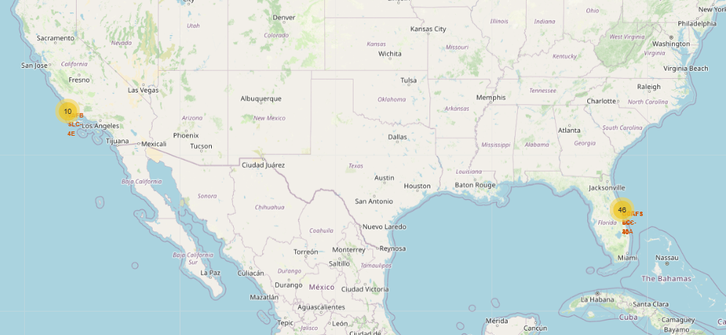
SpaceX launch sites
The three launch sites, are shown on the us map. These include the Cape Canaveral locations and Vandenberg space launch complex
Notes:
Replace <Folium map screenshot 1> title with an appropriate title
Explore the generated folium map and make a proper screenshot to include all launch sites’ location markers on a global map
Explain the important elements and findings on the screenshot

Slide 54
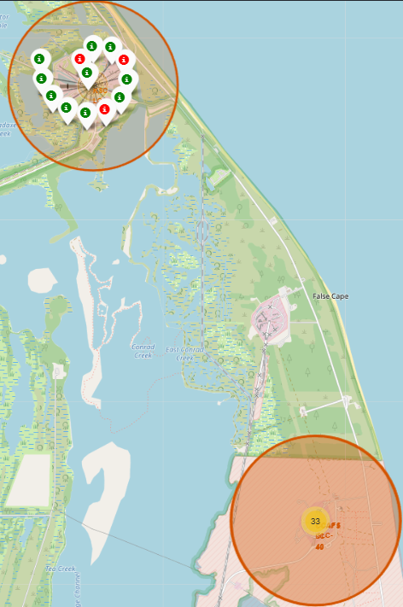
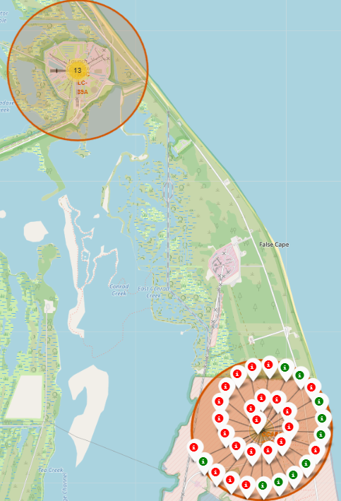
Landing Sites Data Clusters
Each location contains the information of failures and successes in a cluster form. Clicking on them reveals all landings.
Notes:
Replace <Folium map screenshot 2> title with an appropriate title
Explore the folium map and make a proper screenshot to show the color-labeled launch outcomes on the map
Explain the important elements and findings on the screenshot

Slide 55
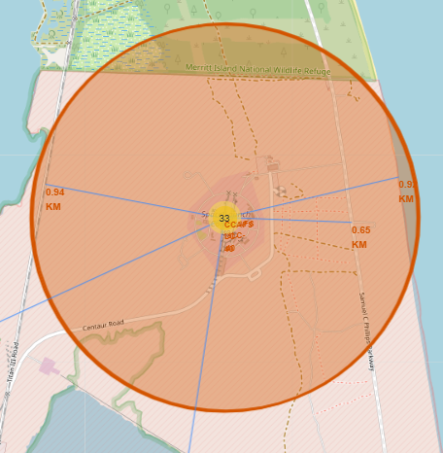
Launch Sites Proximities
Points of interest were selected for each launch site and their distance calculated and annotated on the global map. The points of interest selected were highways, railways, coastlines and major cities. The main pattern found was the position of the launch site and the direction of the main major city was the determining factor of the type of orbit the launch site can launch.
Notes:
Replace <Folium map screenshot 3> title with an appropriate title
Explore the generated folium map and show the screenshot of a selected launch site to its proximities such as railway, highway, coastline, with distance calculated and displayed
Explain the important elements and findings on the screenshot

Slide 56

Section 4

Slide 57
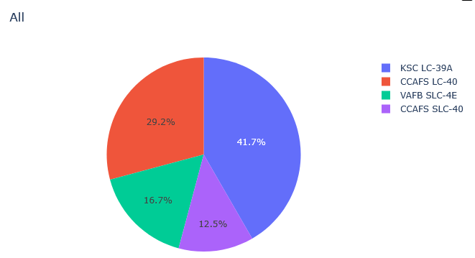
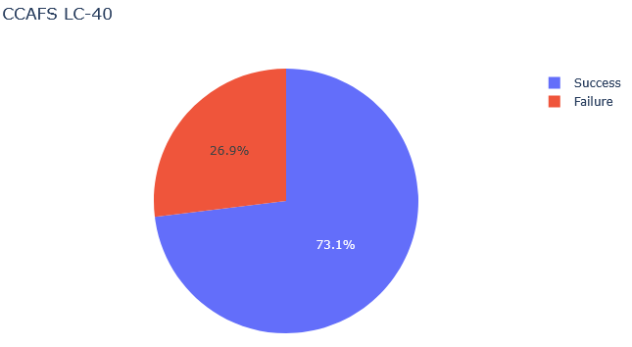
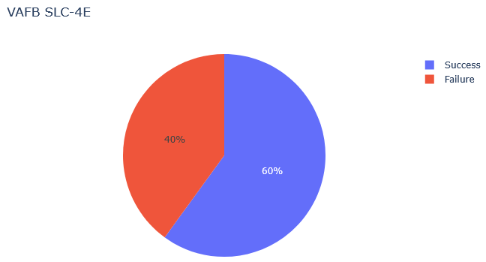
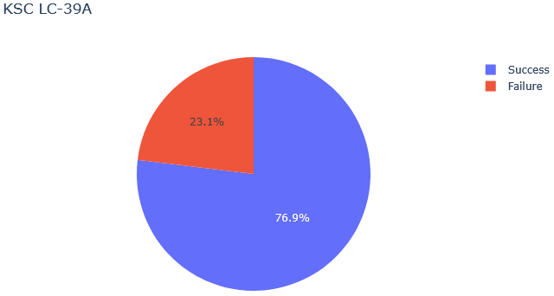
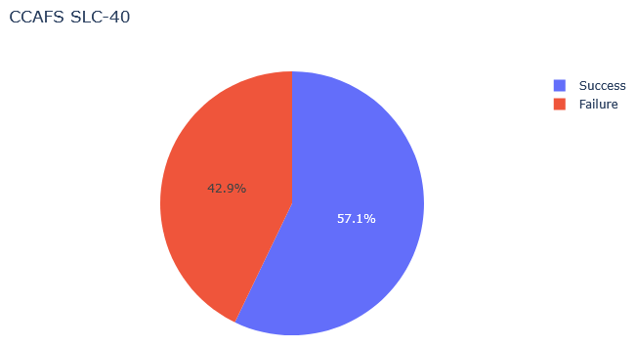
Share of Launches and Rate of Successful Landings
The interactive pie chart showcases the share of launches per site and when selected we can visualize their success rate
Notes:
Replace <Dashboard screenshot 1> title with an appropriate title
Show the screenshot of launch success count for all sites, in a piechart
Explain the important elements and findings on the screenshot

Slide 58
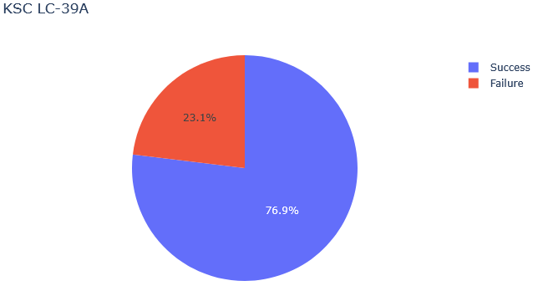
Most Successful Launch Site
Thanks to the interactive quality of the developed pie chart, we can identify with ease the most successful site.
Notes:
Replace <Dashboard screenshot 2> title with an appropriate title
Show the screenshot of the piechart for the launch site with highest launch success ratio
Explain the important elements and findings on the screenshot

Slide 59
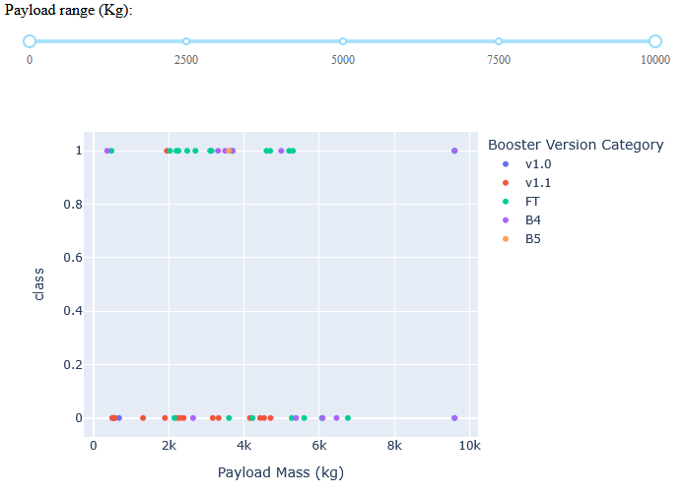
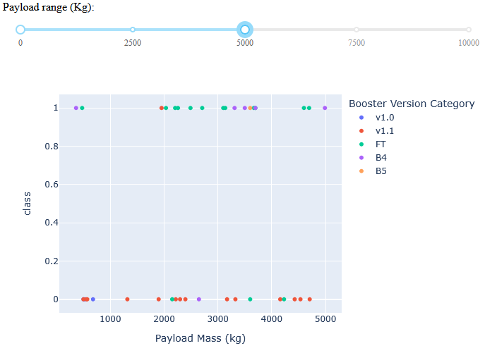
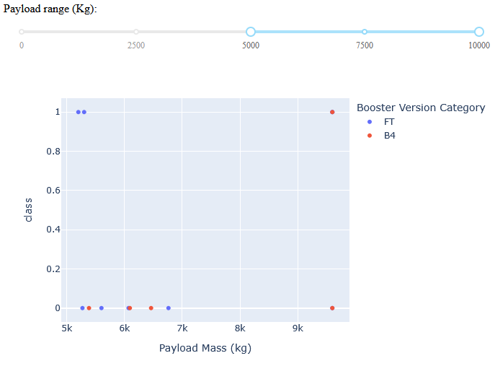
Payload vs. Launch Outcome
The dashboard is also capable to showcase payload vs. launch outcome. We can filter by payload mass using the slider. The scatter plot also considers the launch site selected. We can observe that for launches above 5000 kg the success rate is drastically lower.
Notes:
Replace <Dashboard screenshot 3> title with an appropriate title
Show screenshots of Payload vs. Launch Outcome scatter plot for all sites, with different payload selected in the range slider
Explain the important elements and findings on the screenshot, such as which payload range or booster version have the largest success rate, etc.

Slide 60

Section 5

Slide 61
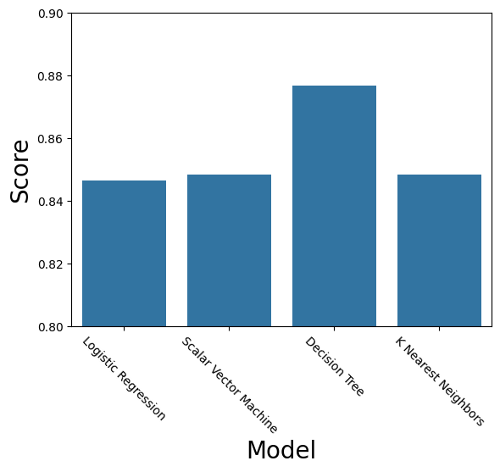
Classification Accuracy
The model with the highest classification accuracy was shown to be the decision tree classifier.

Slide 62

Confusion Matrix
While the most accurate model obtained was the decision tree model, these are known to be unstable models, so their results may vary substantially depending on the initial test data used.
Notes:
Show the confusion matrix of the best performing model with an explanation

Slide 63
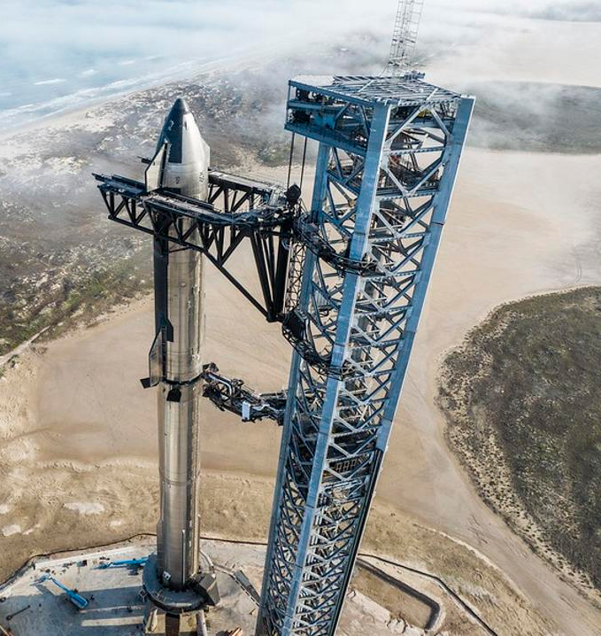
Conclusions
SpaceX landing success rate has been increasing since 2013 to above 80% by 2023.
The success rate is dependent on the difficulty of the mission. Geostationary Transfer Orbit, being the most difficult to land.
Launch site location and proximities depends on the mission to be performed.
Landing outcomes can be predicted up to an 88% of accuracy with a decision tree model.

Slide 64
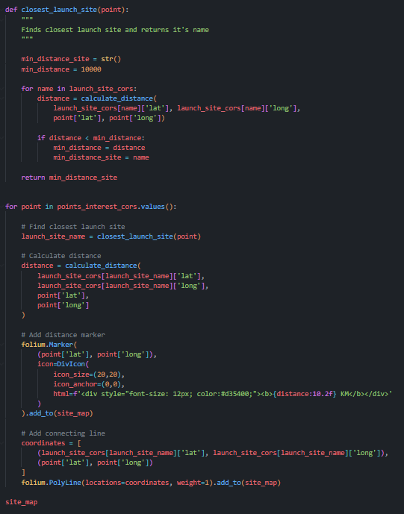
Appendix
A small piece of code was developed to speed up the calculation and annotation of each point of interest to the nearest launch site on the map.

Slide 65


